Slide 1
Learning JSON
Mr. Anbuselvan Annamalai
www.anbuselvan-annamalai.com
- தமிழில்
PART OF MODERN JAVASCRIPT SERIES

Slide 2
What we will learn?
What is JSON?
JSON vs JavaScript Object?
Syntax and differences
How to read JSON files.
Accessing locally!
Accessing through API
How to display data from JSON.
Practical usages
Interview Questions

Slide 3
What is JSON?
JavaScript Object Notation
Lightweight data format for storing and exchanging data
Common use: APIs, local storage, config files, etc.

Slide 4


Aspect | JSON | JavaScript Object
Definition | Text-based format for data exchange. | In-memory data structure in JavaScript.
Syntax | Strict syntax: keys and strings must use double quotes. | Flexible syntax: keys can be unquoted; methods allowed.
Data Types | Supports limited types: string, number, boolean, null, array, object. | Supports all JavaScript data types, including undefined.
Functionality | No methods or executable code. | Can include methods and execute logic.
Purpose | Used for transferring data between systems. (Language Independent) | Used for in-program data manipulation.
Conversion | Requires parsing to convert to JavaScript Object. | Can be directly used in JavaScript programs.

Slide 5
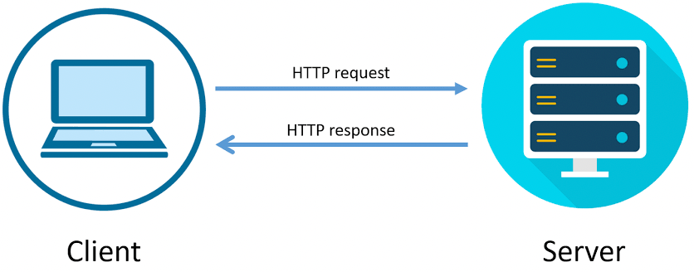
How network resources works?
XML or JSON

Slide 6
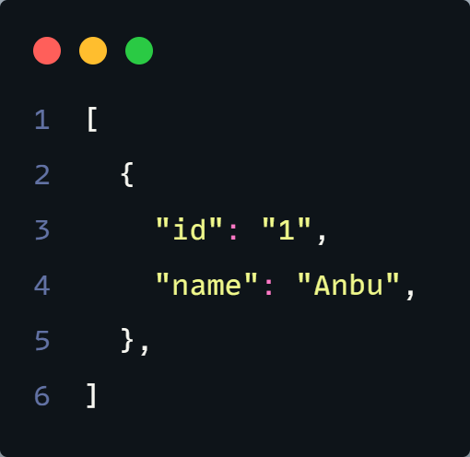
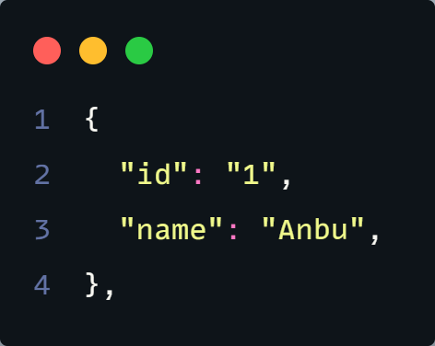
Understand this first!
Array of Objects
Object

Slide 7
Data types
In JSON, values must be one of the following data types:
a string
a number
an object
an array
a boolean
null
In JavaScript values can be all of the above, plus any other valid JavaScript expression, including:
a function
a date
undefined

Slide 8
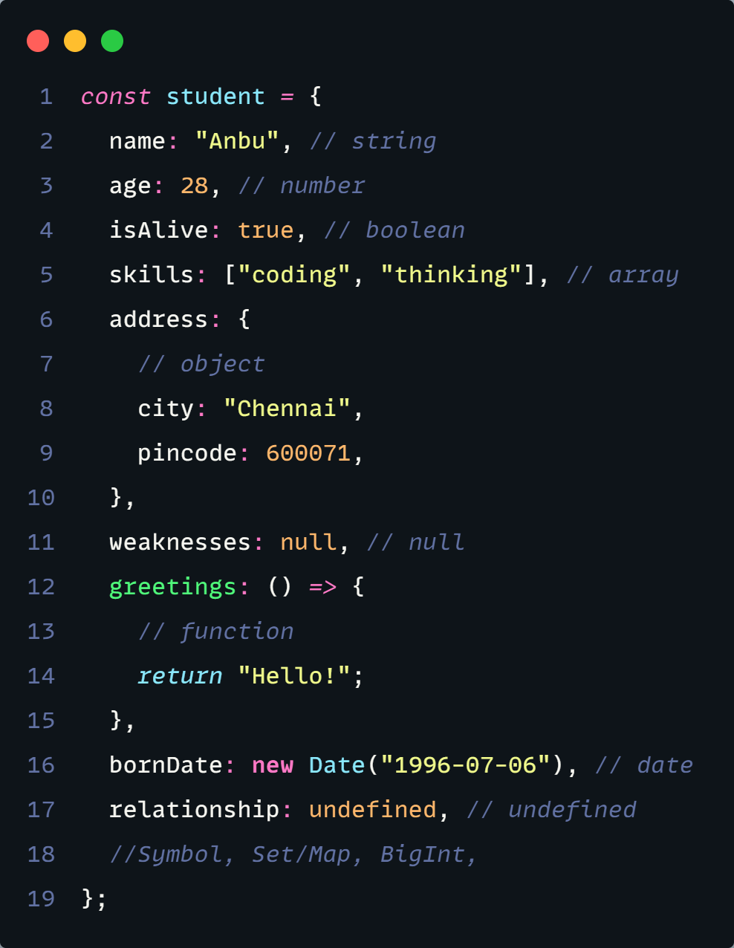
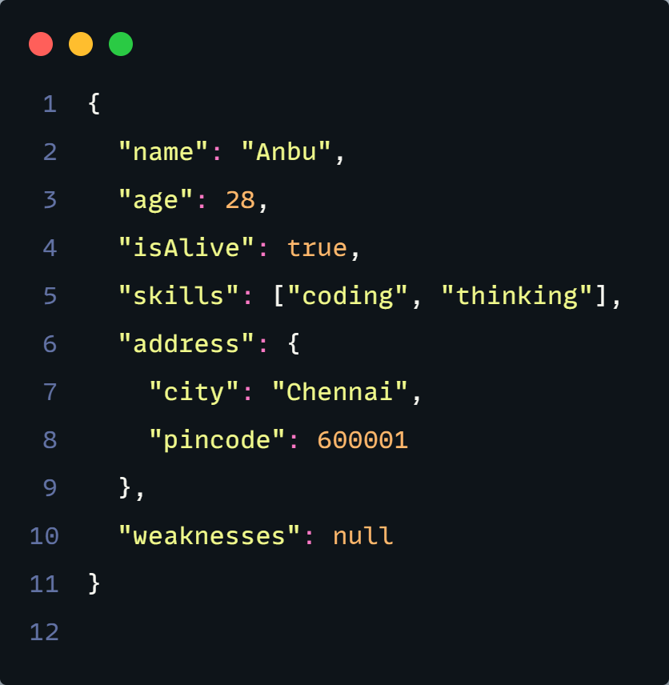
JSON Syntax

